Slide 1
E-Nurse
Using Technology to ensure better care…

Slide 2

Introduction
With the present rate of development, the need for keeping our records updated is also becoming necessary. Information technology is used in nearly every sector including the Medical Industry. Generally data management is one of the many intersection points of this industry with ICT.
With a huge number of patients a hospital is associated with, it becomes harder to keep their record.
The busy lifestyle of people all across the globe hardly leaves any room for other activities, let alone for hospital visits to get their records updated

Slide 3

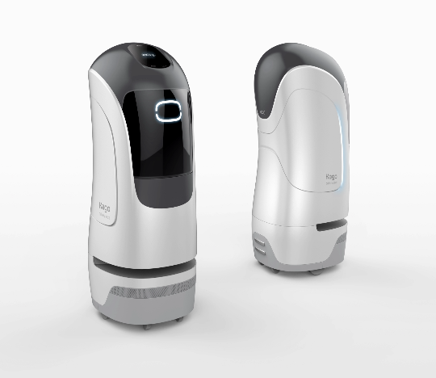
Our Idea: E-Nurse
Purpose:
We are creating app with the purpose to make it easier for the patients to keep track of their records. This will enable them to update information regarding:
General data (Name, Age, etc.)
Medical History (If suffered from any other disorder(s) in the past)
Medications that the patient is allergic to.
Currently ongoing medications & treatment (if-any)
Name of current physician & Guardian
Alongside this app, a medic bot will also be designed to ensure that the patients take their medications on time and that the medication is replenished on time, it will also notify the patient of their pending clinical visit/ make appointments as per their reports and their daily workout routine.

Slide 4
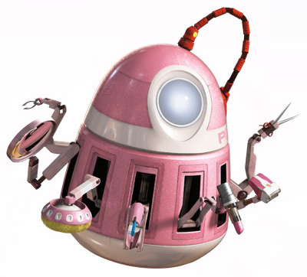
Uniqueness
“All in one”
User will be notified of their upcoming clinical appointments.
Their meds will be orders from the nearest available pharmacy.
They will be notified to take their meds regularly.
Their records will be updated without any hassle.

Slide 5
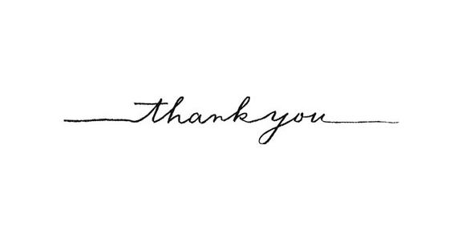
Our Team:
Harsh Sharma
Jaivardhan Singh Tak
Isha Gupta
Somprabha Kashyap

